Slide 1
MPASS - Messaging Platform-As-A-Service

Slide 2
This project is to build a single, centralised communications platform for Users to programmatically send all outbound messages to their customers.

Slide 3
Agenda
Intro
Analysis & Walkthru
Demo & Discussion
Q&A

Slide 4
INTRO

Slide 5


Slide 6
Key Features
Send SMS, WhatsApp
Single EXE, backend is MySQL
Services via REST API
Uses Twilio(due to No-Other-Choice)
Able to handle different message types
Multi-Nodal Parallelism

Slide 7
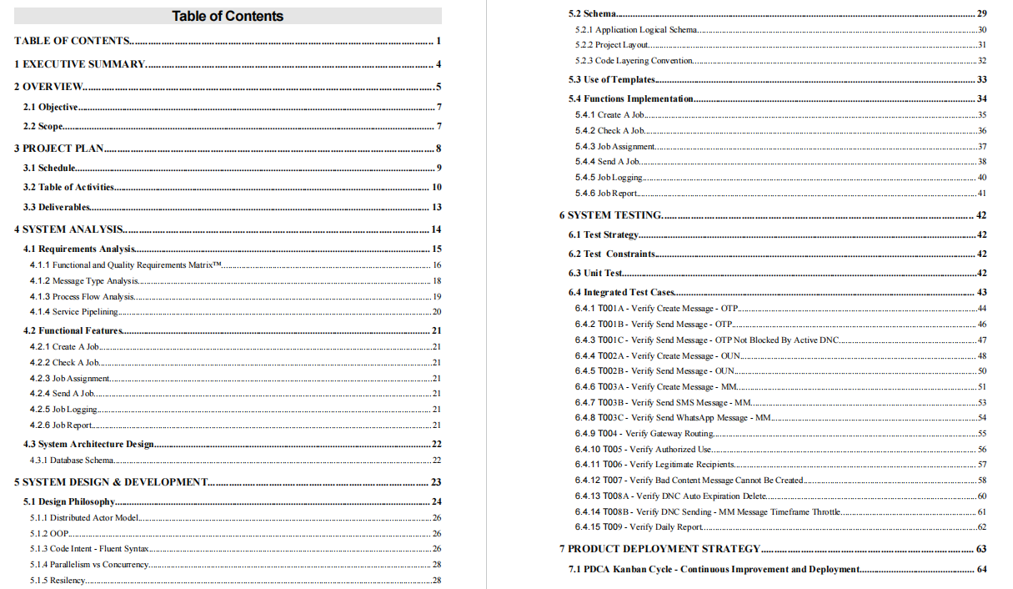
Agenda

Slide 8
WALK-THRU

Slide 9
Analysis & Design
Requirements Analysis
Message Analysis
Process Flow Analysis
Service Pipelining
Database Design
Pillars of a Modern HA Concurrent System

Slide 10
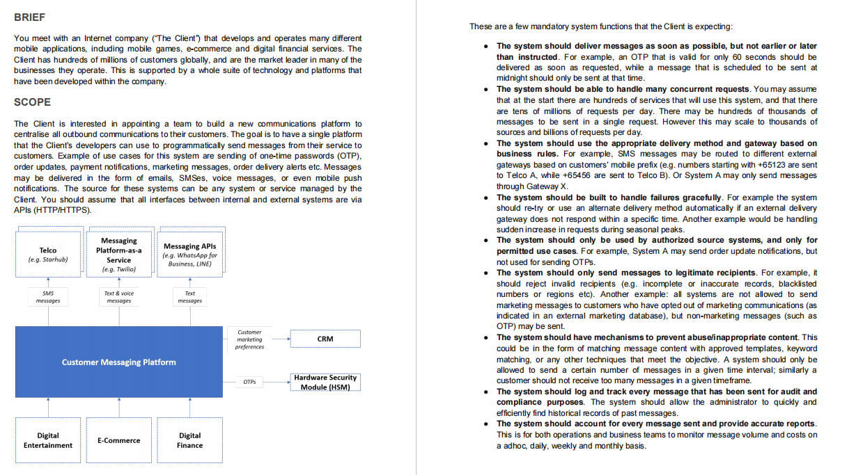

Slide 11
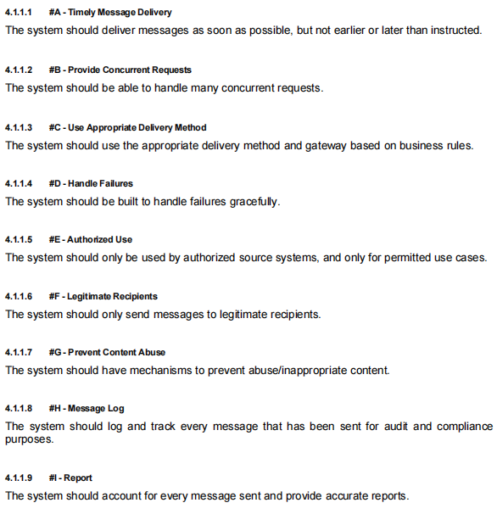
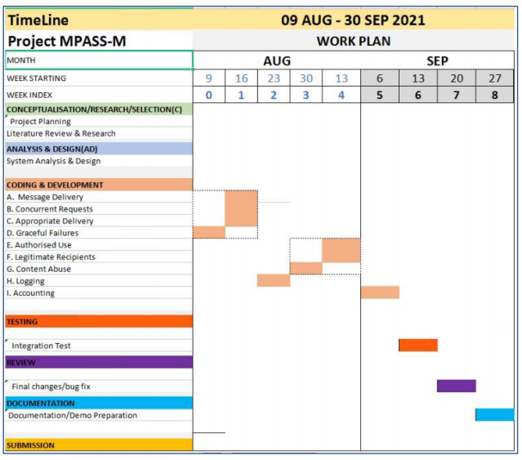

Slide 12
Analysis of Required Message Types
 | Short Message | Notification | Long Message
Recipient | Single | Single | Multi
Time | Instant | Deferred | Scheduled
DNC | No | No | Yes
Examples | OTP | Order Update Notification Payment Notification Order Delivery Alert | Marketing Messages

Slide 13
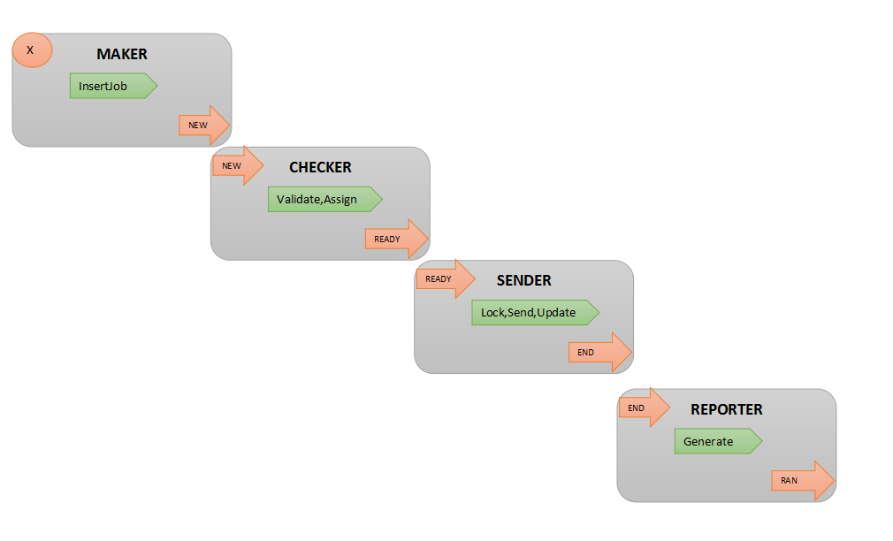
Process Flow
Message sending at the process level is a sequence of actions from different actors.
4 Steps:
Each Step has a Start & End State
Steps are triggered by
User
Timer

Slide 14
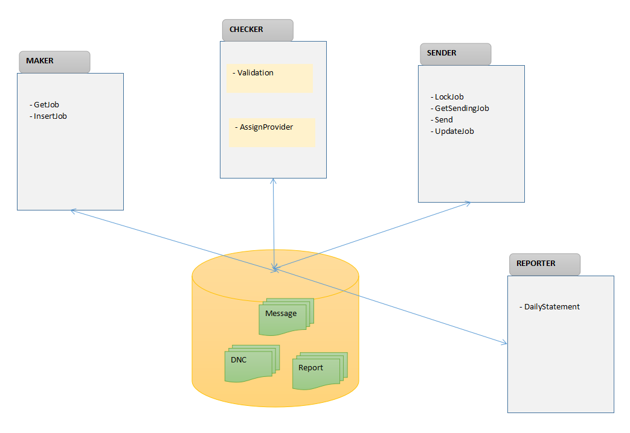
Application Schema
4 Parts:
Maker handles job creation(CRUD)
Checker handles Validation and Assighment
Sender handles the sending by Provider
Reporter handles generating post-transaction data for other applications.

Slide 15
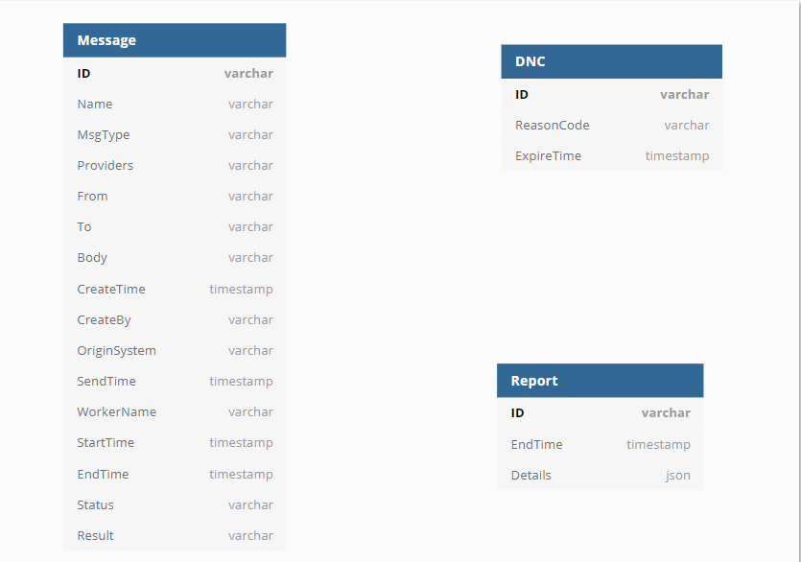
Database Design
Message
Holds the job data to send
DNC
Permanent/Temp Do-Not-Call data.
Report
Report table holds transacted data for downstream applications such as Accounting, Analytics, etc.

Slide 16
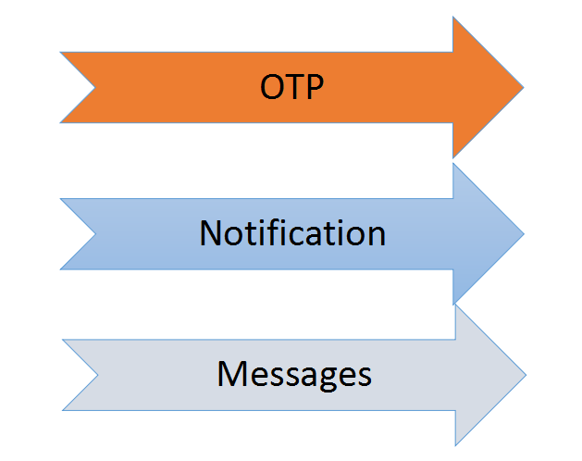
Service Pipelining
The different message types have different performance requirements.
OTP: single, time-sensitive,low volume
Notification:single,non-immediate,moderate load
Messages:multi,non-immediate,high volume/load. May be cost-sensitive.

Slide 17
Builds

Slide 18
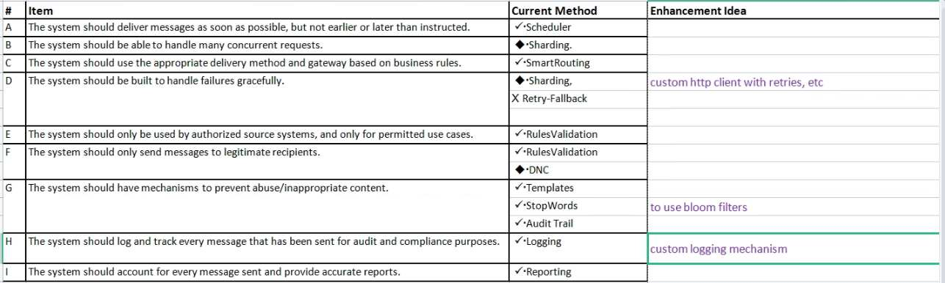
Initial POC

Slide 19
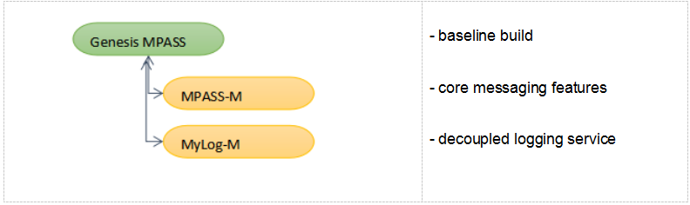
Branching

Slide 20
Decoupled Logging and WebView(myLog)
http logging microservice
allows easy ‘grep’
can support tagging
can support Monitoring, Alerts, Analytics
can support centalized logging

Slide 21
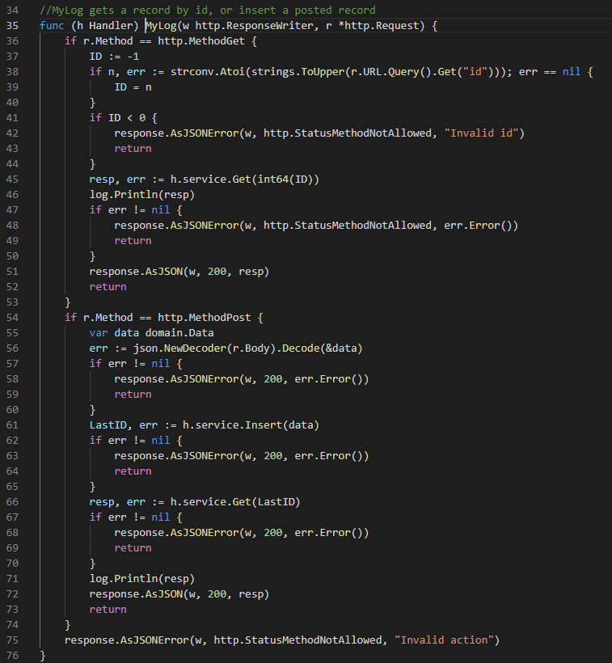
Logging Service
GetLogByID()
InsertLog()
GetLogTail()

Slide 22
CODE WALKTHRU

Slide 23
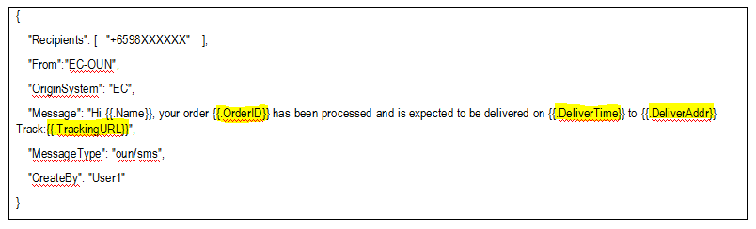
Message Templates

Slide 24
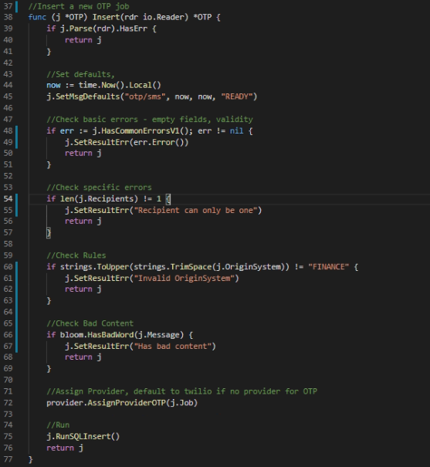
Create Job
Validate
Check Rules
Provider Assignment

Slide 25
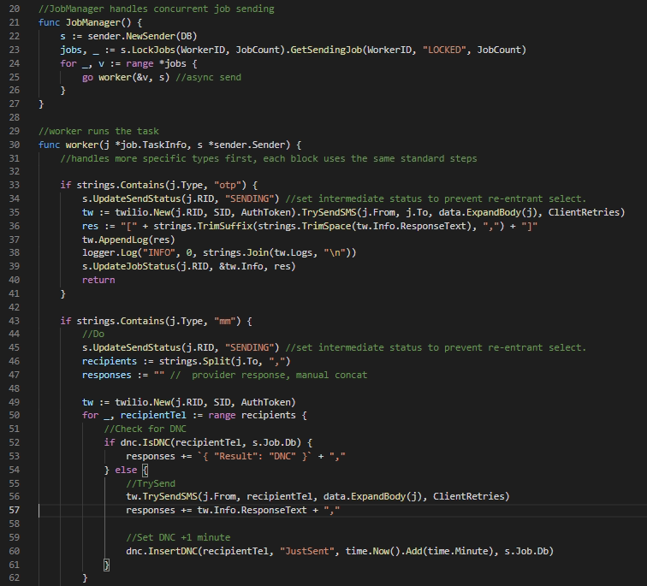
Runs Jobs
Select jobs
Apply Locks
Try send
Update job status

Slide 26
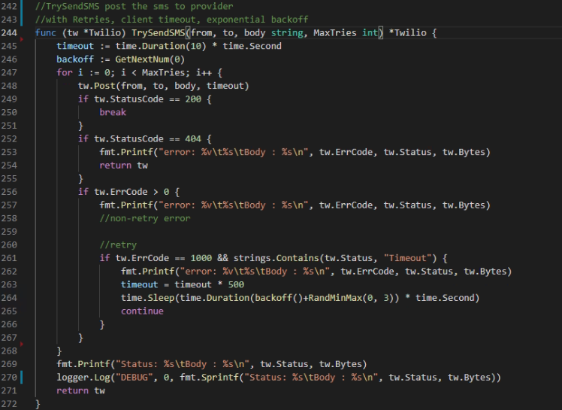
Http Client
Retries - custom
Timeout - double per try
Exp BackOff - doubling + rand 3s jitter
ReTryable Errors

Slide 27
DEMO TIME

Slide 28
OTP
Steps: - Call API from curl/Postman
- MPASS receives the the request and routes to appropriate gateway
EDIT IN POWERPOINT®
Click on the button under the presentation preview that says "Download as PowerPoint template". You will get a .pptx file that you can edit in PowerPoint.
Remember to download and install the fonts used in this presentation (you’ll find the links to the font files needed in the Presentation design slide)

Slide 29
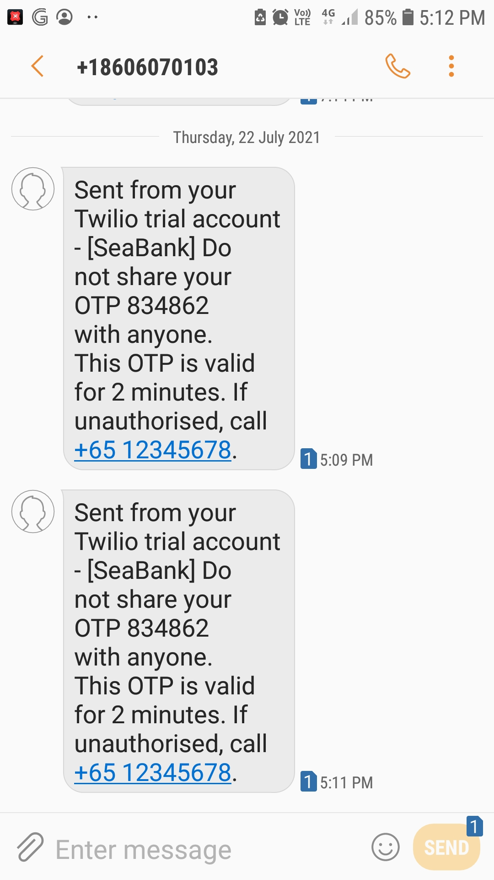
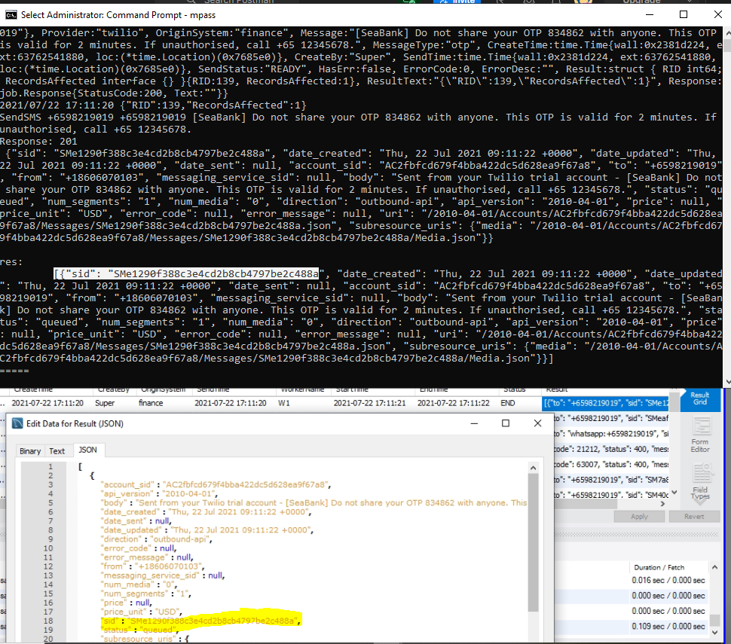
OTP
Results
- OTP message received immediately.

Slide 30
KEY SCENARIOS

Slide 31
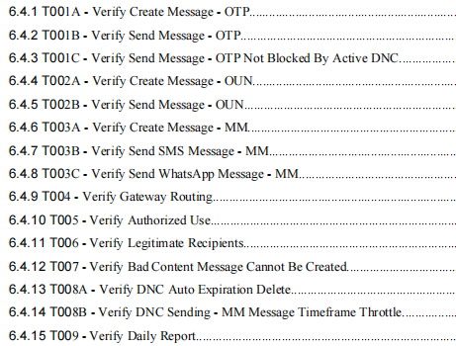
Core Test Scenarios
As soon as possible
Single recipient

Slide 32
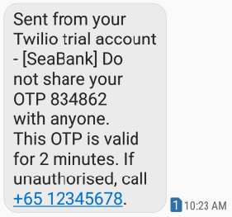
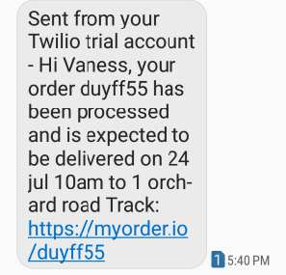
Send SMS
OTP
OUN

Slide 33
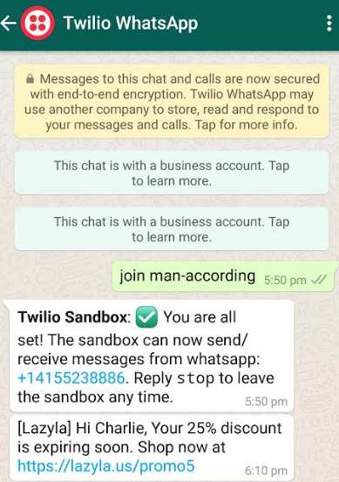
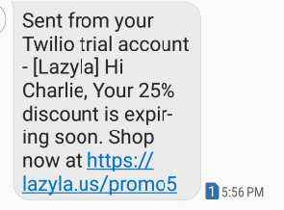
Send SMS/WhatsApp
MM
MM

Slide 34
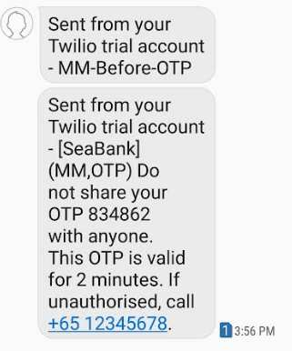
OTP OK, MM DNC
OTP not restricted by DNC

Slide 35
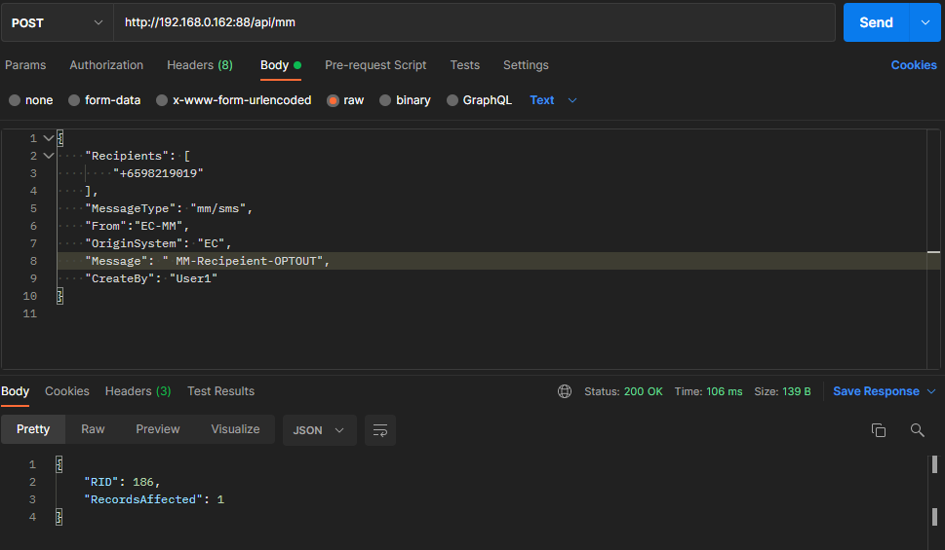
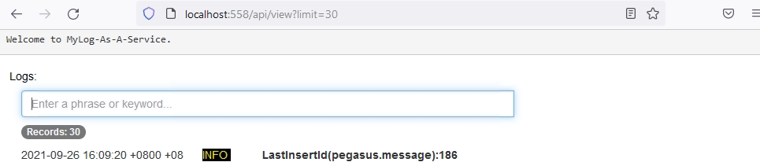
DNC Opt Out
MM not sent if
OptOut

Slide 36
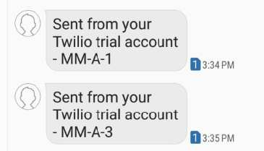
MM Throttle(1 minute)
Customer cannot receive too many MM within a timeframe.
Sending 3 MM messages at T+0s, T+30s, T+61s

Slide 37
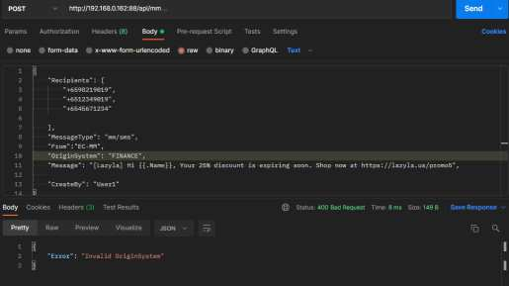
Authorized Use
Finance cannot send MM.

Slide 38
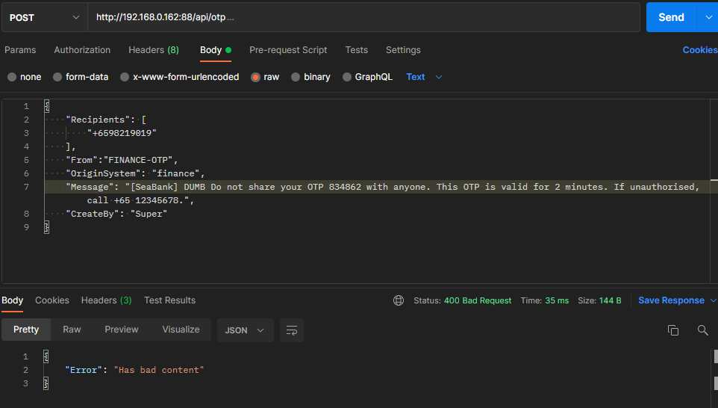
Bad Content
Checking for stopwords.(eg. dumb)

Slide 39
DISCUSSION

Slide 40
Improvement Opportunities Observations
Structure - ‘Han Solo’ team
Project - Progress review timing alignment
Prototype - http over internet has no QoS
Product - Lack of actual telco gateways
Peso - No funding means cannot do mass test.

Slide 41
Pillars of a Modern HA Concurrent System
Concurrency
Fault-Tolerance
Distributed Model
Actor Model
Simplicity
Single Responsibility

Slide 42
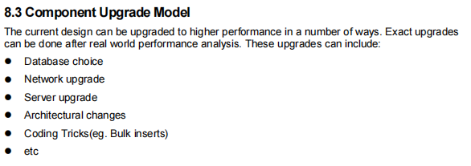
Enhancement Roadmap
Pull Model vs Push Model
Message Model - more formal message format
Upgrades - Various - see report.

